Slide 1
Basic Introduction to SQL

Slide 2
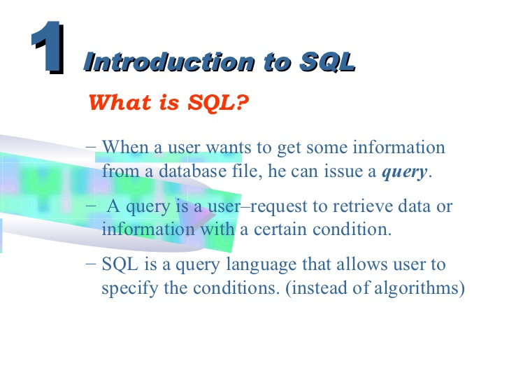

Slide 3
SQL
Language developed by IBM (1970s) to manipulate the data stored in database system
Originally called “Structured English Query Language” (SEQUEL), later it is called SQL “Structured Query language”.
It is the standard language for relational database management systems.
It is a nonprocedural language(means what rather than how).
For Example: Select “customer name” from customer database where rs. in account > 10,000

Slide 4
SQL has several parts:
Data Definition Language (DDL)- Create or modify the database structure
1. Create
2. Drop
3. Alter
Data Manipulation Language (DML) – ability to query information from the database (like select) and to insert, update or delete database structure.
Integrity – commands for specifying integrity constraints that the data stored in the database must satisfy.
View Definition – SQL DDL defines commands for defining views.
Transaction Control – commands for specifying the beginning and ending of transaction.
Authorization – commands for specifying access rights to relations and views.

Slide 5
SQL Data Definition
SQL DDL allows set of relations and information about each relation including:
Schema for each relation
types of each value associated with each attribute
integrity constraints
security and authorization information for each relation
physical storage structure of each relation on disk

Slide 6
Basic Data Types
Data type | Description
CHAR(SIZE) | Character strings value of fixed length. Max characters can hold is 255. The data held is right padded with spaces to whatever length is specified. For example: Name CHAR2(7)= NMIMS--
VARCHAR (SIZE)/VARCHAR2(SIZE) | Store variable length of alpha numeric type. Max characters can hold 255. Inserted values will not be padded with spaces. For example: Name VarCHAR2(7)= NMIMS
Number (size) | store numbers only

Slide 7
Data Type | Description
Numeric (P,S) | store fixed or floating numbers where p is precision and s is scale. Max precision is 38 digits. CGPA(3,1)= (12.3) for example- numeric(7,2) means 5 digits before decimal and 2 digits after decimal.
DATE | represent date and time. standard format is MM-DD-YYYY
LONG | store variable length character string upto 2GB. LONG data can not be used in sub queries, or functions
int or integer | machine dependent finite set of integers.
Float(n) | floating point number with precision of at least n digits.

Slide 8
Data Languages in SQL
DDL (Data Definition Language)
Create, Alter, Truncate, Drop, Rename
DML (Data Manipulation Language)
Insert, Select, Update, Delete
TCL (Transaction Control Language)
Commit , Rollback

Slide 9
Basic Commands of DDL
Create Table
Syntax:
Create table <table name>
(<column name1> <datatype>(<size>),
<column name2> <datatype>(<size>)………
<column nameN> <datatype>(<size>));
Create table student(name varchar2(10), city varchar2(10), class varchar2(10), marks number(5));
Output:
Table Created

Slide 10
(2) Alter Command
Modify the structure of a table: add, delete or rename the table name, also change the datatype of existing column
Adding a new column:
Syntax:
Alter table <table name> ADD ( < NewColumn1> <Datatype> (size), ….. < NewColumnN> <Datatype> (size) );
For Example:
Alter table Student ADD ( Marks number(5))
Name | City | Class | Marks

Slide 11
Dropping a column from a table
Syntax:
Alter Table <Table Name> DROP Column <Column Name>;
For Example: Drop the column name Marks from the student table
Alter Table Student DROP COLUMN Marks;
Name | City | Class
John | Mumbai | B.Tech
Rahul | Mumbai | MCA

Slide 12
C ) Modifying Existing Columns
Syntax:
Alter Table <Table Name> MODIFY (<Column Name> <New Datatype> (<NewSize>) );
For Example: Alter Student table to allow NAME field to store alphanumeric datatype upto 30 characters.
Alter Table Student MODIFY (Name varchar2(30) );

Slide 13
(3) Rename Command
Rename the table name
Syntax
RENAME <Tablename> TO < NewTableName>;
Alter table <table name> Rename to <New Table name>
For Example: Rename student table name to student record
RENAME Student TO Student_Record;
Alter table student rename to student_record;
Rename Column Name
Alter table table_name rename column old column_name to new_column name
Alter table student rename column Marks to New_Marks

Slide 14
(4) Drop Command
The DROP command removes a table from the database. All the tables' rows, indexes and privileges will also be removed.
Syntax
Drop Table <Tablename>;
(5) Truncate Command
TRUNCATE removes all rows from a table permanently.
Syntax
Truncate Table <Tablename>;

Slide 15
Insert Command
Commands of DML
Syntax:
Insert into <table name> (<column name1>, <colum name2>…….<column nameN> ) values (<expression 1>, <expression2>……..<expressionN>);
Insert into student (Name, City, Class, marks) values (‘John’, ‘mumbai’, ‘B.Tech’, 3);
Insert into student values (‘Rahul’, ‘Delhi’, ‘MCA 1’, 7);
Insert into student (name) values (‘rahul’);
Output:
2 rows created
Char
Number
VarChar

Slide 16
Insert Null Values
Syntax:
INSERT INTO <table_name> ( Column1, column2 )
VALUES ( Value1, null);
Insert Date Format
Syntax:
Insert into table_name (addmission_date) values ((To_date(’19-04-2017’, ‘DD-MM-YYYY’))

Slide 17
For example
insert all
into Student(name, marks) values(‘John', 1)
into student (name, marks) values(‘Roy', 3)
into student(name, marks) values(‘ram', 4);
For inserting Multiple values:
Insert into <table name>(Column1, column 2, ….column n) values(&Column1, '&column2',… &column n);
For Example:
insert into emp (empno, ename, sal) values(&empno, '&ename', &sal); Enter value for empno: 123 Enter value for ename: RADHI Enter value for sal: 25000

Slide 18
Insert Date Values:
insert into table_name values(to_date('24/11/2017','DD/MM/YYYY'));
Example:
Insert into employee (id, Joining_date) values (1, (to_date('24/11/2017','DD/MM/YYYY));

Slide 19
Select Command
It is used for retrieving the records from the database
Syntax:
Select * from tab;
(This command is used to show the entire tables of the database)
Select * from tablename;
(This command is used to show the entire record of the particular table)
Example: Select * from student;
Select <column name>, <column name>……<n column name> from tablename;
Example: select name, marks from student;

Slide 20
Table in SQL
Select * from student
Student
Name | City | Class
John | Mumbai | 2
Rahul | Delhi | MCA 1

Slide 21
Table in SQL
Student
Name
John
Rahul
Select name from student

Slide 22
Filtering Table Data
Selected columns and all rows
Selected rows and all columns
selected columns and selected rows

Slide 23
Selected columns and all rows:-
Retrieval of specific columns from a table
Syntax::
select <column1>, <column2> from <table name>;
Select name , city from student;
Name | City
John | Mumbai
Rahul | Delhi

Slide 24
Selected rows and all columns:- using where clause
Retrieval of specific rows from a table
Syntax::
select * from <table name> where<condition>;
Select * from student where name=‘john’;
Name | City | Class
john | Mumbai | 2

Slide 25
Selected rows and selected columns:-
Retrieval of specific rows and specific column from a table
Syntax::
select <column1>, <column2> from <table name> where<condition>;
Select Name, city from student where name=‘john’;
Name | City
John | Mumbai

Slide 26
Updating a Table
Change or modify the data values in a table in terms of :
a) All the rows
Syntax:
Update <Tablename> set <columnname1>= <Expression1>, <columnname2> = <Expression2>……..n;
b) Update records with condition
Syntax:
Update <Tablename> set <columnname1> = <Expression1> where <condition>;

Slide 27
a) Update Student SET Name = ‘John’;
b) Update Student SET City = ‘Mumbai’ where City = ‘Delhi’;
Name | City | Class
John | Mumbai | B.Tech
Rahul | Delhi | MCA
Ram | chennai | MBA
Name | City | Class
John | Mumbai | B.Tech
John | Delhi | MCA
John | chennai | MBA
Old Table
New Table
Name | City | Class
John | Mumbai | B.Tech
Rahul | Mumbai | MCA

Slide 28
Delete Command
Delete is used to remove either:
All the rows from table or A set of rows from a table
Syntax:
1) DELETE from <table name>;
For Example: Delete all the records of students
DELETE from Student;
Name | City | Class

Slide 29
2) DELETE from <table name> where <condition>;
For Example: Delete all the records of those students who live in Mumbai city.
Delete from student where city =‘Mumbai’;
Name | City | Class
John | Mumbai | B.Tech
Rahul | Delhi | MCA
Name | City | Class
Rahul | Delhi | MCA
Updated Table
Old Table

Slide 30
Sorting Data in to Table
Table to be viewed in a sorted order either in ascending or descending order depending on the condition.
Syntax:
SELECT * From <Table Name> Order BY (< Column Name1>…<Column Name N ) <[Sort Order] >;
Note: By default ascending order but for descending order use DESC after the specified column

Slide 31
For Example: Show the details of the students according to their marks
Select * from Student Order By Marks;
Name | City | Class | Marks
John | Mumbai | B.Tech | 10
Rahul | Delhi | MCA | 9
Herry | Mumbai | MCA | 10
Name | City | Class | Marks
Rahul | Delhi | MCA | 9
John | Mumbai | B.Tech | 10
Herry | Mumbai | MCA | 10
Old Table
Select name from Student Order By Marks DESC;

Slide 32
Select name from Student Order By Marks DESC;
Name
Rahul
Herry
John

Slide 33
Distinct Command
Eliminating duplicate rows from the table.
To view only unique rows
Syntax:
Select DISTINCT * from <table name>;
Select DISTINCT <Column Name> from <Table Name>;

Slide 34
Data Constraints in SQL
SQL constraints are used to specify rules for the data in a table
Constraints can be specified during Create Table and Alter Table
In SQL, we have the following constraints:
NOT NULL - Indicates that a column cannot store NULL value
UNIQUE - Ensures that each row for a column must have a unique value
PRIMARY KEY - A combination of a NOT NULL and UNIQUE. Ensures that a column (or combination of two or more columns) have an unique identity which helps to find a particular record in a table more easily and quickly

Slide 35
FOREIGN KEY - Ensure the referential integrity of the data in one table to match values in another table
CHECK - Ensures that the value in a column meets a specific condition
DEFAULT - Specifies a default value when specified none for this column
Syntax:
CREATE TABLE table_name ( column_name1 data_type(size) constraint_name, column_name2 data_type(size) constraint_name,…….);

Slide 36
Data Constraints: Not Null
The NOT NULL constraint enforces a column to NOT accept NULL values.
The NOT NULL constraint enforces a field to always contain a value. This means that you cannot insert a new record, or update a record without adding a value to this field.
For Example:
Create table Bank( Bank_ID number Not Null, Branch_Name varchar2(10), Loan_No Varchar2(10) not null);
Insert into Bank Values (11, ‘Mumbai’, ‘L-201’);
Insert into Bank (Bank_ID) values (‘’);
Insert into Bank values (12, ‘Chennai’, ‘’);
Error in both commands

Slide 37
Adding Not Null Constraint
Alter table Bank Modify (Branch_Name Varchar2(10) Not Null);
Drop the Not Null Constraint
Alter Table Bank Modify (Branch_Name Varchar2(10) Null);
(The above syntax will remove Not Null constraint from the column)

Slide 38
UNIQUE CONSTRAINT
The UNIQUE constraint uniquely identifies each record in a database table like primary key
Only difference is that we can have many UNIQUE constraints per table, but only one PRIMARY KEY constraint per table.
For Example:
CREATE TABLE Employee ( E_Id number(10), LastName varchar2(10) NOT NULL, FirstName varchar2(10) UNIQUE, Address varchar2(10) not null UNIQUE, City varchar2(10) );
Alter table Employee Drop Unique;
Alter table Employee Drop Unique(Address);

Slide 39
Data Constraints: Primary Key
Primary key is used to identify unique records
It can not accept null values
In primary key, the data held across the column must be unique
Only one primary key is allowed per table
One table can combine upto 16 columns in composite primary key (or candidate key)
Syntax: <Column Name> <data type size> Primary key
Create table Loan ( loan_number varchar2(10) Primary key, customer_name varchar2(10) );
OR
Create table customer (name varchar2(10), city varchar2(10), primary key (name, city));
Composite Key

Slide 40
Add Primary Key Constraint:
Syntax:
Alter Table TableName ADD Primary Key (column name);
Example:
Alter table Salesman ADD Primary Key (sales_no);
Drop Primary Key Constraint
Syntax: Alter Table TableName Drop Primary Key;
Example: Alter Table Salesman Drop Primary Key;

Slide 41
Foreign Key (Referential Integrity) Constraint
Foreign key represents relationships between two tables
A foreign key is a column (or groups of columns) whose values are derived from the primary key of other table (master table)
Foreign key column can have null or duplicate records
Records can not be inserted into foreign key table if corresponding records in the master table does not exist
Records of the master table can not be deleted if corresponding records in foreign key table actually exist

Slide 42
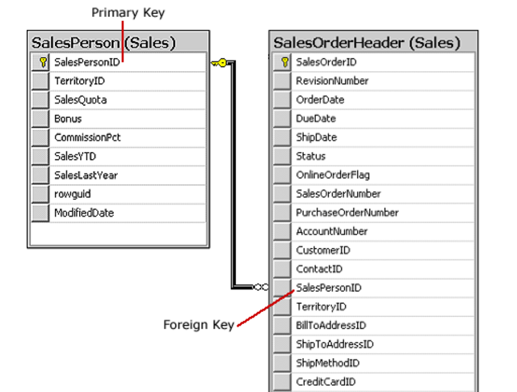

Slide 43
Syntax:
<column name> <Data Type> References <Table Name> <column name>
For Example:
Create table Customer_master (Cust_id number(5) primary key, address char(10) default ‘India’, loan_no number(6));
Create table emp_database (emp_no number(5) primary key, name varchar2(10), designation varchar2(10) , C_no number (10) References customer_master (Cust_id), salary number(5));
OR
Create table emp_database (emp_no Number(5) primary key, name varchar2(10), designation varchar2(10) , C_no number (10), salary number(5), foreign key (C_No) References customer_master (Cust_id));

Slide 44
Create table student (id number(10) , name varchar(20), class char(20), primary key(id));
Create table course(Course_id number(10), c_name char(20), S_id number(10) references student(id), date_of_conduct date))
Or
Create table course(Course_id number(10), c_name char(20), S_id number(10), date_of_conduct date), foreign key (S_id) references student(id))
id | name | class
1 | john | 2
2 | Riya | 5
3 | Rahul | 7
4 | Bhavesh | 4
Cpurse_id | C_name | S_id | date
11 | Physics | 2 | 3 sep
12 | Chemistry | 2 | 4 sep
13 | maths | 4 | 5 aug

Slide 45
Add a Foreign Key: (2 ways to add Foreign Key)
ALTER TABLE Tablename ADD FOREIGN KEY (column_name) REFERENCES Master_Tablename (Column_name);
ALTER TABLE Tablename ADD (column_name) REFERENCES Master_Tablename (Column_name);
Drop Foreign Key : use disable keyword to drop fK
Alter table tablename Add (column_name) REFERENCES Master_Tablename (Column_name) disable

Slide 46
Add foreign key using constraint name
Alter table customer_master ADD Constraint F_ID Foreign Key (S_id) references student (id);
Drop Foreign Key:
ALTER TABLE TableName DROP Constraint F_ID;

Slide 47
CHECK CONSTRAINT
The CHECK constraint is used to limit the value range that can be placed in a column.
Syntax:
<column name> <data type> CHECK (Condition)
For Example:
CREATE TABLE Persons ( P_Id number(10) NOT NULL CHECK (P_Id>=10), LastName varchar2(20) NOT NULL, FirstName varchar(25), Address varchar2(20) );
CREATE TABLE Customer ( C_Id number(5) Primary Key , Name varchar2(20), address varchar2(20) ,
check (Name Like ‘C%’), Check(Name =UPPER(Name) );

Slide 48
To add check constraint
Alter table cust_master ADD check (cust_no>1);
To drop check constraint
Alter table cust_master modify (Cust_no number (5) check (cust_no>1) disable);

Slide 49
Default CONSTRAINT
The DEFAULT constraint is used to provide a default value for a column. The default value will be added to all new records if no other value is specified.
For Example:
CREATE TABLE Employee ( E_Id number(10) Primary Key, LastName varchar2(10) NOT NULL, FirstName varchar2(10), City varchar2(10) default ‘London’);
Insert into Employee (E_Id, Lastname, FirstName) values (11, ‘John’, ‘Pareira’);
Select * from Employee;
Output
E_id FirstName LastName City
11 John Pareira London

Slide 50
Add Default constraint
Alter TABLE Employee modify(City default ‘London’);
Disable Default Constraint
Alter TABLE Employee add (City default ‘London’ disable);

Slide 51
Insert into Employee values (12, ‘Tommy’, ‘Pary’, ‘Paris);
Select * from Employee;
Output
E_id FirstName LastName City
11 John Pareira London
Tommy Pary Paris
Note: By default value will be London but we can also update the value at the time of insert records.

Slide 52
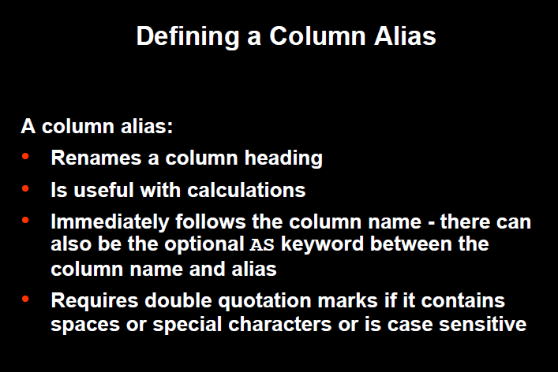

Slide 53
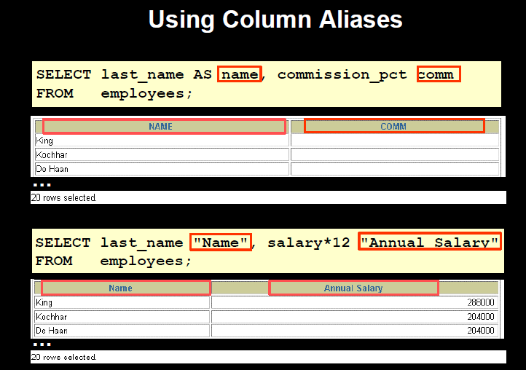

Slide 54
Logical Operators
AND : It is used for creating SQL statement with two or more conditions and all conditions must be satisfied.
OR : It is used for creating SQL statement with two or more conditions and any one condition should be satisfied.
3. NOT : It is used for displaying those records which does not satisfy the condition.

Slide 55
AND:
Find out the client no, name and salary of those clients who live in mumbai city and due balance is greater than and equal to 1000
SQL> Select client_no, name, salary from client_master where city=‘mumbai’ AND Bal_Due >=1000;
Client_no | Name | Salary
C001 | Ivan | 4000
C005 | Lara | 2000

Slide 56
OR:
Find out the client no, name and salary of those clients who live in mumbai city or due balance is greater than and equal to 1000
SQL> Select client_no, name, salary from client_master where city=‘mumbai’ OR Bal_Due >=1000;
Client_no | Name | Salary
C001 | Ivan | 4000
C004 | William | 6000
C005 | Lara | 2000

Slide 57
NOT:
Find out the client no, name and salary of those clients who are not in the city ‘mumbai’ and balance is not greater than 1000
SQL> Select client_no, name, salary from client_master where NOT ( city=‘mumbai’ AND Bal_Due >1000);
Client_no | Name | Salary
C002 | Ivan | 4000
C003 | Harry | 3000
C004 | William | 6000
C005 | Lara | 2000

Slide 58
Arithmetic Operators
Addition (+)
Subtraction (-)
Division (/)
Multiplication (*)
Enclosed Operation ()

Slide 59
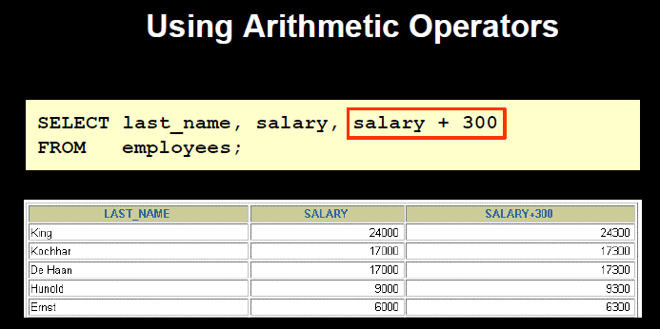

Slide 60
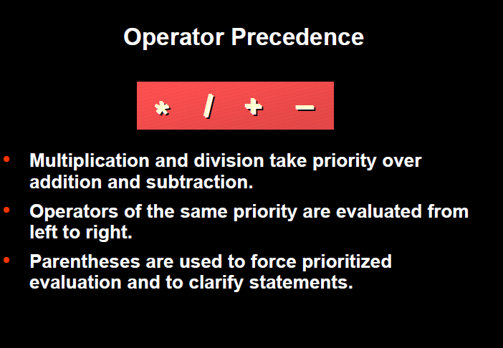

Slide 61
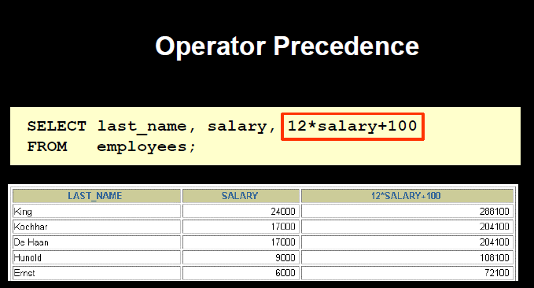

Slide 62
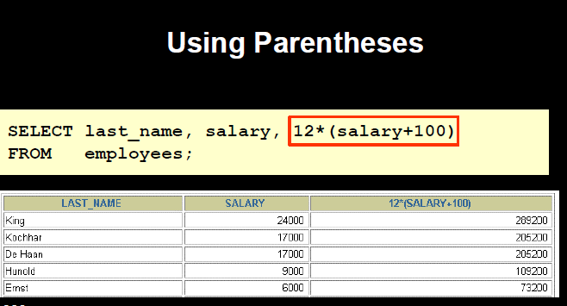

Slide 63
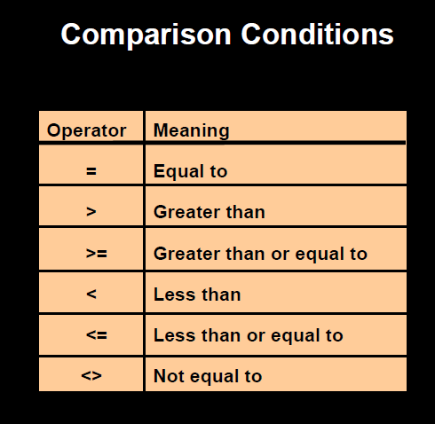

Slide 64
Range Searching (Between Operator)
Retrieve data within range of values.
BETWEEN operator allows the selection of rows that contains values within specified limit.
The range coded after the word BETWEEN in inclusive and two values in between the range must be linked with a keyword AND.
Syntax: Select * from <table name> where condition BETWEEN <expression> AND <expression>

Slide 65
Select description from product where sellprice BETWEEN 100 AND 300
Description
Books
Pens
Bags
Pencils
Select description from product where sellprice NOT BETWEEN 100 AND 300
Description
Folders

Slide 66
IN Operator
To test for values in a list.
Syntax: Select * from <TableName> where condition IN (expression);
Select name from client where salary IN (4000, 3000)

Slide 67
Rules of Precedence
Order | Operator
1 | Arithmetic Operators (**, * ,/, +, -)
2 | Comparison Operators
3 | IN
4 | BETWEEN
5 | Logical Operators (NOT, AND, OR)

Slide 68
Aggregate Functions
Aggregate functions are functions that take a collection of values as input and return a single value.
The SQL Aggregate Functions are functions that provide mathematical operations like add, count or avg.
Behavior of Aggregate Functions:
Operates - on a single column
Return - a single value.

Slide 69
Types of SQL Aggregate Functions
SUM
AVG
MIN
MAX
COUNT
Operates only on collection of numbers.
Operates on numbers and non numbers as well.

Slide 70
SUM()
The sum of the values in a specified column.
Syntax:
Select SUM (column name) from <table name> where <condition>; OR
For Example: Select SUM (salary) from client ;
OR
Select SUM (salary) AS Total_Salary from client ;
Sum(salary) OR Total_Salary
29000 29000

Slide 71
AVG()
The average of the values in a specified column.
Syntax:
Select AVG (column name) from <table name> where <condition>;
For Example: Select AVG (salary) from client ;
AVG(salary)
9.666666

Slide 72
Min()
It returns the smallest values in a specified column.
Syntax:
Select MIN (column name) from <table name> where <condition>;
For Example: Select MIN (sell_price) from product ;
Min(marks)
9

Slide 73
Max()
It returns the maximum value in a specified column.
Syntax:
Select MAX (column name) from <table name> where <condition>;
For Example: Select MAX (salary), Avg(salary) from client ;
Max(marks)
10

Slide 74
COUNT()
Returns the Number of records in a specified column where expression is not null.
Syntax:
Select COUNT (Column Name) from <Table Name>;
For Example:
Select COUNT (name) from Emp;
COUNT(name)
3
How many different job titles are stored in the relation EMP?
-→ select count(distinct JOB) from EMP;

Slide 75
COUNT(*)
Returns the total Number of records in a specified column.
Syntax:
Select COUNT (*) from <Table Name>;
For Example:
Select COUNT (*) from Emp;
COUNT(*)
4
Empid | Name | Job_Title
1 | John | Project_Leader
2 | Peter | Project_Leader
3 | Herry | Engineer
Null | Null | engineer

Slide 76
Set Operations
SQL supports few SET Operations on data table.
These functions are used to get meaningful results from different conditions.
There are 3 types of Set operations:
UNION, UNION ALL (U)
INTERSECT, INTERSECT ALL (∩)
EXCEPT (-)

Slide 77
Set Operation: UNION
It is used to store result of two or more select statement.
It will eliminate duplicate records from the result after combining two or more select statement.
In Union operation- number of columns and datatype should be same in both tables.
Syntax:
select <column name> from table name1 UNION select <column name> from table name2
OR
select <column name> from table name 1 where condition UNION select <column name> from table name 2 (or 1) where condition

Slide 78
Client_ID | Name
c001 | Ivan
c002 | John
Cust_ID | Name
c002 | John
c003 | William
C004 | Lara
CLIENT
Employee
select clinet_id, name from CLIENT UNION select cust_id, name from employee
Client_ID | Name
c001 | Ivan
c002 | John
C003 | Willaim
c004 | Lara

Slide 79
select client_id, name From CLIENT UNION ALL select clust_id, name from CUSTOMER
Client_ID | Name
c001 | Ivan
c002 | John
C002 | John
c003 | William
c004 | Lara

Slide 80
Set Operation: INTERSECT
It is used to combine two select statement or tables and return the common result.
In intersect operation, number of columns and datatype should be same in both tables or statements.
Syntax:
select <column name> from table name1 INTERSECT select <column name> from table name2
OR
select <column name> from table name 1 where condition INTERSECT select <column name> from table name 2 where condition

Slide 81
Client_ID | Name
c001 | Ivan
c002 | John
Cust_ID | Name
c002 | John
c003 | William
C004 | Lara
CLIENT
Employee
select clinet_id, name from CLIENT INTERSECT select cust_id, name from Employee
Client_ID | Name
c002 | John

Slide 82
Set Operation: EXCEPT OR MINUS
Combine results of two select statement and return only those results which is in first set.
Syntax:
select <column name> from table name1 minus select <column name> from table name2
OR
select <column name> from table name 1 where condition minus select <column name> from table name 2 where condition

Slide 83
Client_ID | Name
c001 | Ivan
c002 | John
Cust_ID | Name
c002 | John
c003 | William
C004 | Lara
CLIENT
CUSTOMER
select clinet_id, name from CLIENT Minus select cust_id, name from CUSTOMER
Client_ID | Name
c001 | Ivan

Slide 84
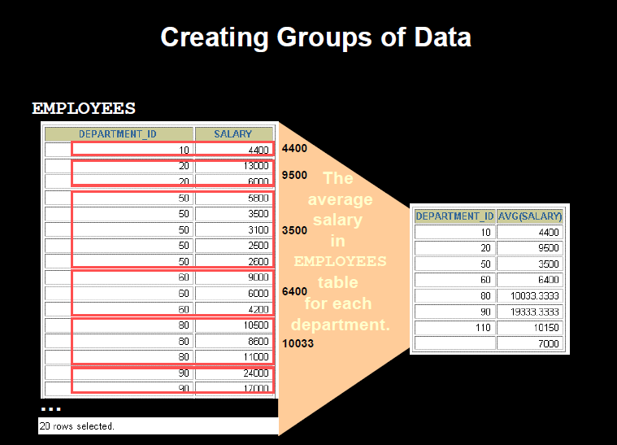
GROUP BY CLAUSE

Slide 85
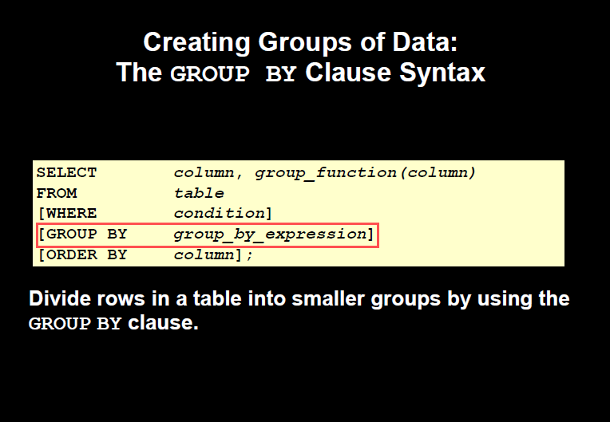

Slide 86
To displays avg salary of employees work for each department?
SELECT Avg (salary) “Avg salary“, dpt_id
FROM employee
GROUP BY dpt_ID;
Dep_id Avg Salary
---------- ------------
1 100
3 3000
7 4000

Slide 87
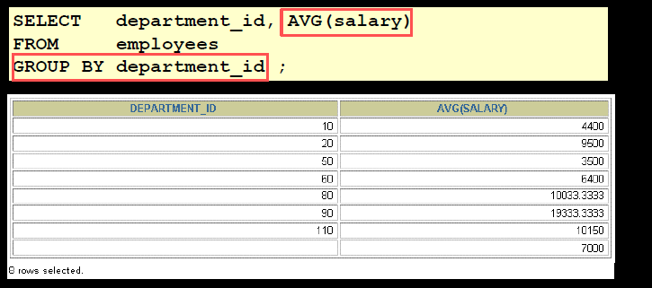

Slide 88
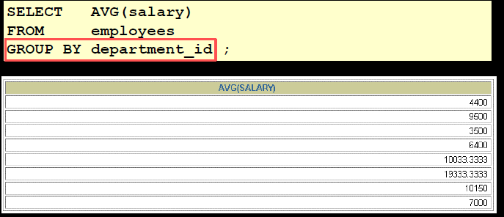

Slide 89
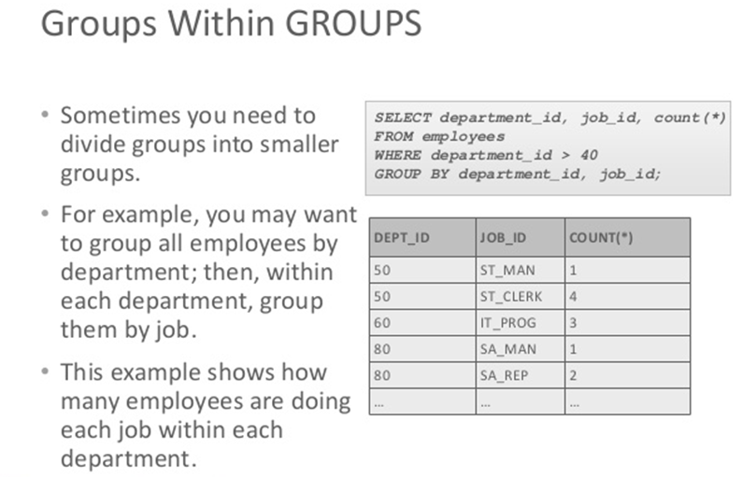

Slide 90
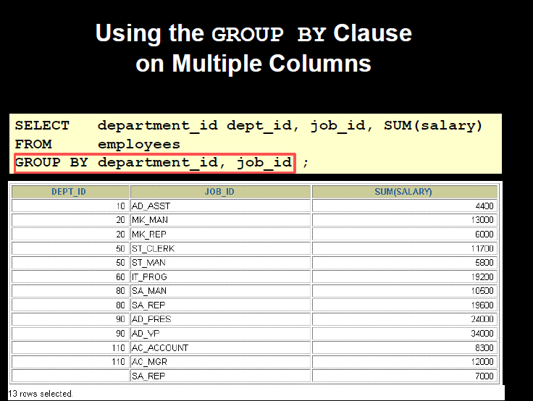

Slide 91
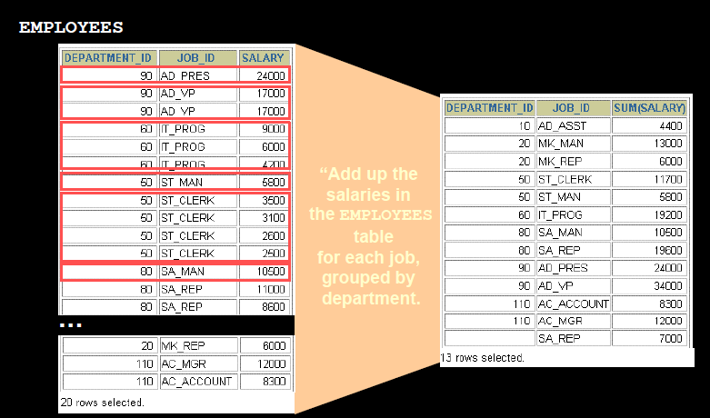

Slide 92
Points to remember
If you have column name(s) AND Aggr. Function(s) in the SELECT clause, then you MUST also have a GROUP BY clause.
The column name(s) in the SELECT clause MUST match column name(s) listed in the GROUP BY clause.
Example:
SELECT emp_dpt_number "Department",
emp_gender "G",
COUNT(*) “Employee Count"
FROM employee
GROUP BY emp_dpt_number, emp_gender;

Slide 93
Having clause
The HAVING clause specifies conditions that filter which group results appear in the final results.
The WHERE clause places conditions on the selected columns, whereas the HAVING clause places conditions on created groups.
This is a further condition applied only to the aggregated results to restrict the groups of returned rows. Only those groups whose condition evaluates to TRUE will be included in the result set.
The HAVING clause must follow the GROUP BY clause in a query and must also precede the ORDER BY clause if used.

Slide 94
The HAVING clause is a conditional option that is directly related to the GROUP BY clause option because a HAVING clause eliminates rows from a result table based on the result of a GROUP BY clause.
In Oracle, A HAVING clause will not work without a GROUP BY clause
Syntax:
SELECT column1, column2 FROM table WHERE [ conditions ] GROUP BY column HAVING [ conditions ] ORDER BY column

Slide 95
To display employee department no, total no. of departments, max and min salary of each department having max salary greater than 3
SELECT dpt_number "Department",
COUNT(*) "Department Count",
MAX(emp_salary) "Top Salary",
MIN(emp_salary) "Low Salary“
FROM employee
GROUP BY dpt_number
HAVING max (salary) >= 3;
Department Department Count Top Salary Low Salary
---------- ---------------- ---------- ----------
3 3 $43,000 $25,000
7 4 $43,000 $25,000

Slide 96
Find out the product description and total quantity of the products having average sell price greater than 100.
Select description , count (quantity) from products GROUP BY description HAVING avg(sell-price)> 100;
To return the name of the department and the total sales of the associated department with product total sales greater than 25,000
SELECT department, SUM(sales) AS "Total sales" FROM product GROUP BY department HAVING SUM(sales) > 25000;

Slide 97
Pattern Matching: Use of LIKE Predicate
The LIKE operator is used to search for a specified pattern in a column.
The SQL LIKE condition can be used in any valid SQL statement : Select, Insert, Update and Delete
The patterns that can be chosen from wild cards (%, _ )
% allows to match any string of any length (including zero length)
_ allows to match on a single character
Syntax: SELECT column_name(s) FROM table_name WHERE column_name LIKE pattern;

Slide 98
Customer
Cust_ID | Name
c002 | John
c003 | Jini
C004 | Lara
C005 | William
Retrieve the customers records whose name starting with ‘J’
select Cust_ID, Name from customer where Name LIKE ‘J%’ ;
Retrieve the customers records whose name begins with ‘La’
select Cust_ID, Name from customer where Name LIKE ‘La%’ ;
Retrieve the customers records whose name ending with ‘I’
select Cust_ID, Name from customer where Name LIKE ‘%i’ ;

Slide 99
Retrieve the customers records whose names have second character as o or I
select Cust_ID, Name from customer where Name LIKE ‘_o%’ or Name Like ‘_i%’ ;
Retrieve the customers records whose names have second last character as n
select Cust_ID, Name from customer where Name LIKE ‘%n_’;
Retrieve the customers records whose names starts with ‘w’ and third last character is ‘a’
select Cust_ID, Name from customer where Name LIKE ‘W%a__’;
CREATE TABLE Customer ( C_Id number(5) Primary Key , Name varchar2(20), address varchar2(20) ,
check (Name Like ‘C%’), Check(Name =UPPER(Name) );

Slide 100
Return the employee records whose employee name contains the letter ‘s’
Select * from employee where Name Like ‘%s%’;
EMP-ID | NAME | SALARY
1002 | Jane Anderson | 5750
1003 | Brad Everest | 71000
1004 | steven | 57890
Return the employee records whose salary is of 4 digits and starting with 57
Select * from employee where salary LIKE ‘57__’;
EMP-ID | NAME | SALARY
1002 | Jane Anderson | 5750
Return the employee records whose salary starts with 57
Select * from employee where salary LIKE ’57%’;
EMP-ID | NAME | SALARY
1002 | Jane Anderson | 5750
1004 | Steven | 57890

Slide 101
Not LIKE
Using the NOT keyword allows you to select records that does NOT match the pattern.
Syntax: SELECT column_name(s) FROM table_name WHERE column_name NOT LIKE pattern; ( or <> LIKE pattern)
Retrieve the customers records whose names do not start with ‘J’
select Cust_ID, Name from customer where Name Not LIKE ‘J%’ ;
Retrieve the customers records whose names do not have pattern ‘oh’
select Cust_ID, Name from customer where Name NOT LIKE ‘%oh%’ ;

Slide 102
The Oracle Table- DUAL
DUAL is a dummy table owned by system. System has its own data dictionary and DUAL is a part of this dictionary.
DUAL is a oracle table which contains a single row and single column.
For viewing table structure
DESC DUAL ;
b) For retrieving records from DUAL table
Select * from DUAL;

Slide 103
Apply Arithmetic Operation
Select 2*2 from DUAL;
Select ¾ from DUAL;
SYSDATE
Select SYSDATE from DUAL;

Slide 104
Numeric Functions
ABS : Returns absolute value on ‘n’ from either DUAL or created Table.
Syntax: ABS(n)
Select ABS(-20) “Absolute” from DUAL;
Output: Absolute
-----------------------------------
20
2. POWER : Returns m raised to the nth power. N must be an integer.
Syntax: POWER( m, n)
Select POWER(3, 2) “Power” from DUAL;
Output: power
-------------------------------
9

Slide 105
ROUND: Returns rounded value
Syntax: ROUND(n[m])
Select ROUND(23.66, 1) “ROUND” from DUAL;
Round
---------------------------
23.7
4. SQRT: Return square root on n.
Syntax: SQRT(n)
Select SQRT(16) “Square Root” from DUAL;
Square Root
---------------------------------------------
4
5. GREATEST : Returns greatest value
Syntax: GREATEST(expr1, expr2, …exprn)
Select GREATEST(16, 20, 25) “GREATEST” from DUAL;

Slide 106
6. LEAST: Returns smallest value
Syntax: LEAST(expr1, expr2, …exprn)
Select LEAST(16, 20, 25) “LEAST” from dual;
LEAST
----------------------
16
7. MOD: Returns the remainder of a first number divided by second number
Syntax: MOD(m, n)
Select MOD(15, 7) “MOD” from DUAL;
MOD
---------------------
1
8. TRUNC: Returns a number truncated to a certain number of decimal places
Syntax: TRUNC(number, [decimal place] )
Select TRUNC(125.342, 1) “TRUNC” from DUAL;
TRUN
------------------------
125.3

Slide 107
9. FLOOR: Returns the integer value that is equal to or less than number
Syntax: FLOOR(n)
Select FLOOR(24.8) “FLOOR” from DUAL;
FLOOR
-------------------------
24
10. CEIL: Returns the integer value that is equal to or greater than number
Syntax: CEIL(n)
Select CEIL(24.8) “ceil” from DUAL;
ceil
-----------------
25

Slide 108
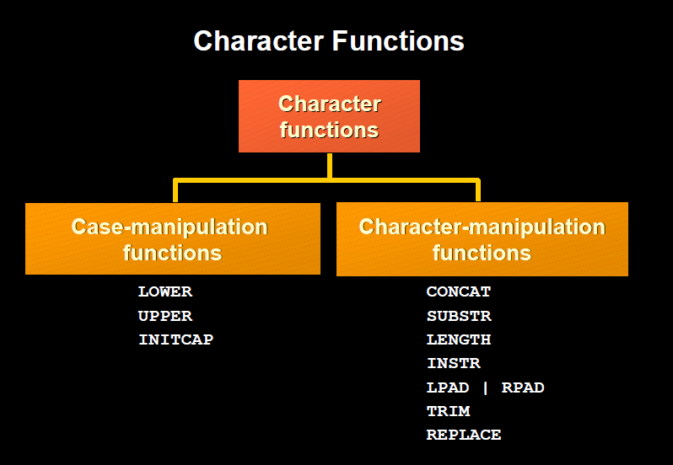

Slide 109
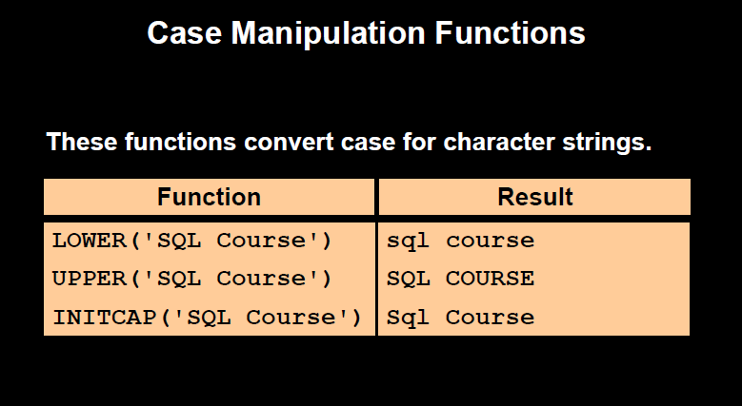

Slide 110
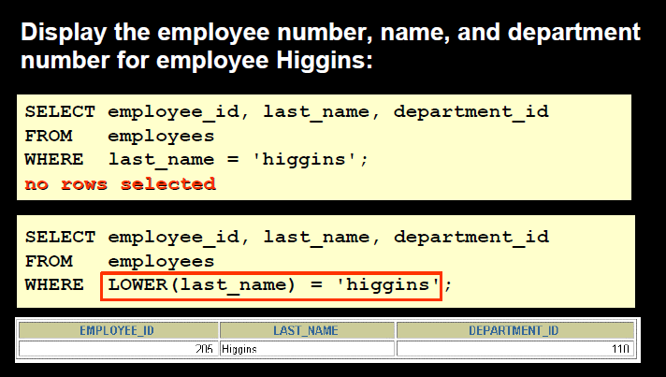
Syntax:
Select LOWER (‘SQL course’) from dual;
Select UPPER (‘Sql Course’) from dual;
Select INITCAP (‘SQL COURSE’) from dual;

Slide 111
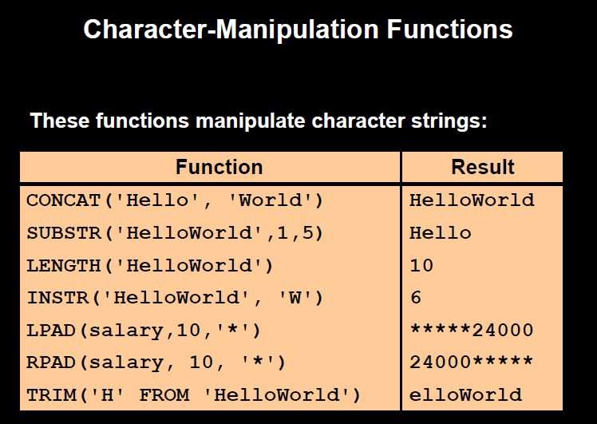
Note: trim is used for trimming first or last character or unwanted spaces

Slide 112
Select CONCAT (‘hello’, ‘world’) from dual;
Select SUBSTR (‘DATABASE’, 3, 4) from dual;
Select ASCII (‘a’), ASCII (‘B’) from dual;
Select Length (‘SQL’) from dual;
Select LTRIM (‘DBMS’, ‘D’) from dual;
Select RTRIM (‘DBMS’, ‘S’) from dual;
Select LPAD (‘SQL’, 6, ‘*’) from dual;
Select RPAD (‘SQL’, 6, ‘*’) from dual;
Select INSTR (‘HelloWorld’, ‘W’) from dual;

Slide 113
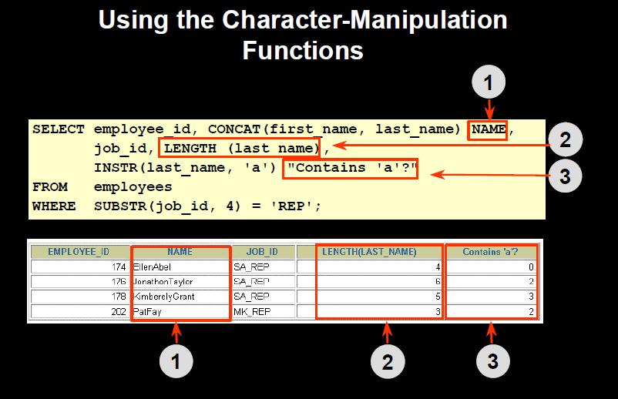

Slide 114
Working with Dates
Create Table: Date is a datatype and bydefault format is “DD-MON-YY’’
Insert Values: Enter value according to the data format.
Example: Create table Employee (DOB date);
Insert into Employee values (‘21-JUL-92’);
Column Name
Datatype

Slide 115
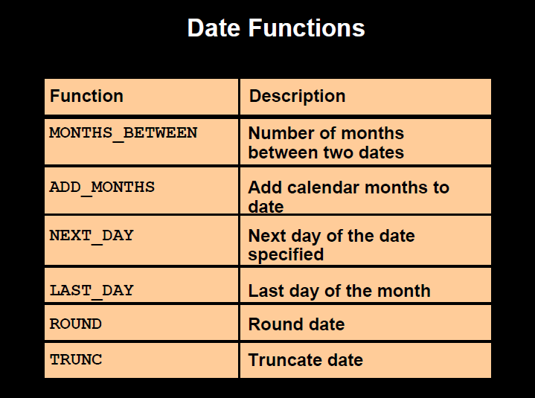

Slide 116
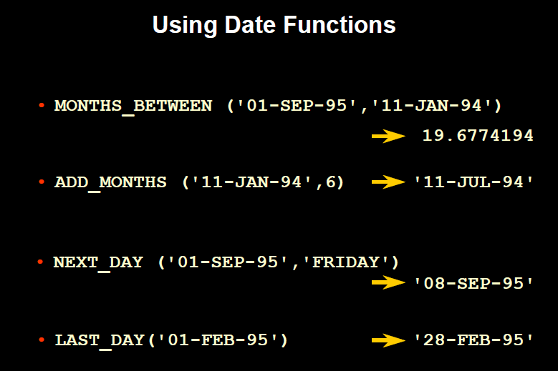

Slide 117
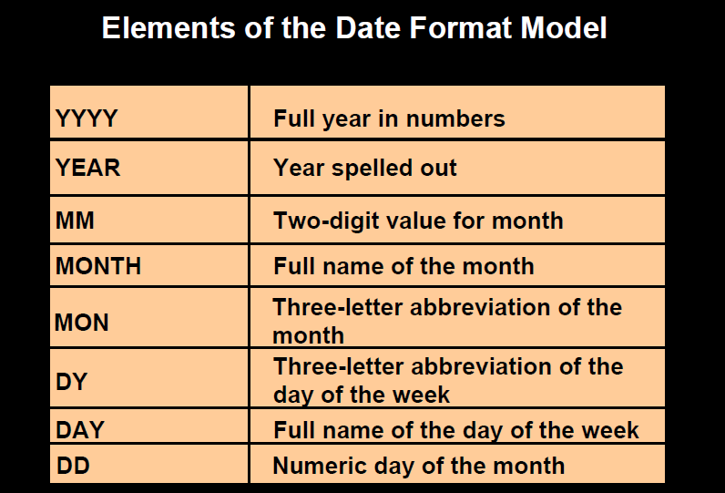

Slide 118
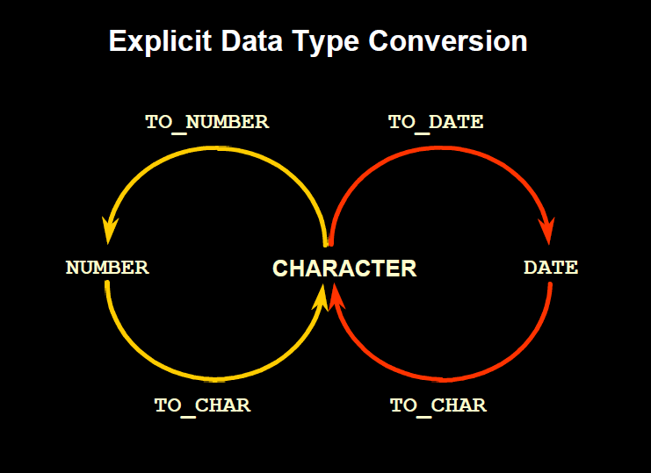

Slide 119
To_CHAR ()
Retrieval date into different format from the default format.
It converts date value into character values
Syntax: To_Char (<date value> [<fmt>]
where date value = date and fmt = format of output date
Example:
Select To_Char(SYSDATE, ‘DD-MM-YY’) from Dual;
Output: 21-09-13

Slide 120
To_Date ()
It converts character values into date value
Syntax: To_date(<char value> [<fmt>]
where char value = date and fmt = format of output date (bydefault system date)
Example:
Select To_date(’21/09/13’, ‘DD/MM/YY’) from Dual;
Output: 21-SEP-13

Slide 121
Creating Table from a Table
Syntax:
Create Table < Table Name> (<Column Name>, <Column name>) AS SELECT <column name>, <column name> from <Table Name>;
Create table course (name, class) As Select name, class from student;
Create table course1 (name, class, score) As Select name, class, marks from student;
Table Name Changed

Slide 122
Inserting Data into a table from another table
Syntax:
Insert into <Tablename> Select <ColumnName1>, < ColumnName N> from <Table Name>;
Insert into <Tablename> Select <ColumnName1>, < ColumnName N> from <Table Name> Where <Condition>;
For Example: insert into Course select name, city, marks from student where marks=10;

Slide 123
VIEWS in SQL
A view is a virtual table contains rows and columns, just like a real table. The fields in a view are fields from one or more real tables in the database.
Syntax:
CREATE VIEW view_name AS SELECT column_name(s) FROM table_name WHERE condition
For Example:
Create View product_vw AS select description from product where city = ‘Mumbai’ Order by city
Create View product_vw AS select description, QTY from product where city = ‘Mumbai’ Group BY description;

Slide 124
Retrieving Records from View
Syntax:
Select column(s) from VIEW;
For Example:
Select description from product_vw;
To Delete VIEW:
Drop View <View Name>
NOTE– Update and Delete commands in view work same as work on table only difference is that use view name rather than table name

Slide 125
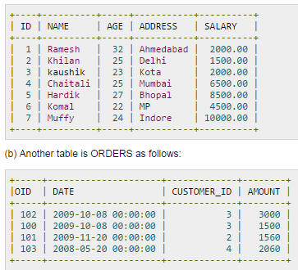
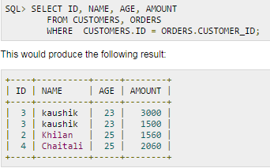
JOINS
SQL joins are used to combine rows from two or more tables based on a common field between them

Slide 126
In SQL, there are various types of joins:
Natural Join
Inner Join
Equi Join
Outer Join
Left Outer Join
Right Outer Join
Full Outer Join
Tables are joined on columns that have same datatype and size

Slide 127
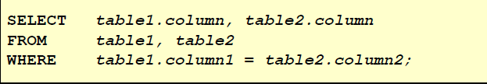
Inner Join
It is a natural join used for retrieving records from more than two tables having common data
Inner join can be Equi join if it is having equal condition only
Syntax:
Select column 1, column 2…., column N from Table 1 Inner Join Table 2 ON Table1.Column1= Table2.Column2 Where condition Order BY Column

Slide 128
Emp_No | Name | Dept_No
11 | Smith | B001
23 | William | B007
34 | Simi | C006
Dept_Name | Dept_No
CS | B001
EC | B007
CS | C009
CS | F007
Employee
Dept
List out the employee number, name and department names in which they belong?
Select e.emp_no, e.name, d.dept_name from Employee e INNER JOIN Dept d ON d. dept_no= e. dept_no ;
Select e.emp_no, e.name, d.dept_name from Employee e, Dept d where d. dept_no= e. dept_ no ;

Slide 129
List out those employee details along with their department name whose name starts with S
Select e.emp_no, e.name, d.dept_name from Employee e INNER JOIN Dept d ON d. dept_no= e. dept_no where e.name LIKE ‘S%’ ORDER BY e. name ;
Select e.emp_no, e.name, d.dept_name from Employee e, Dept d where d. dept_no = e. dept_no and e.name LIKE ‘S%’ ORDER BY e. name ;

Slide 130
Employee
Emp_No | Name | Branch_No
11 | Smith | B001
23 | William | B007
34 | Simi | C006
22 | terry | F007
List out the employee details along with their accounts and branch no of Mumbai branch
Select e.emp_no, e.name, a. acct_no, b.branch_no from Account a INNER JOIN Branch b ON a. branch_name = b. branch_name INNER JOIN employee e ON e.branch_no = b. branch_no where b.branch_name=‘Mumbai’
Acct_no | Branch_name
1008 | Mumbai
1007 | PUNE
1021 | Calcutta
Account
Select e.emp_no, e.ename,
a . acct_no, b. branch_no from account a, branch b, employee e where
a. branch_name = b.branch_name and
b.branch_no = e. branch_no and b.branch_name=‘Mumbai’
Branch_Name | Branch_No
Mumbai | B001
Mumbai | B007
Pune | C006
Branch

Slide 131
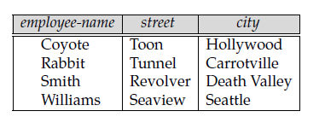
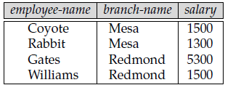
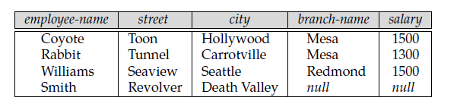
Left Outer Join
The LEFT JOIN keyword returns all rows from the left table (table1), with the matching rows in the right table (table2).
The result is NULL in the right side when there is no match.
Table 1
Table 2
Table 1 Left Join Table 2
Resultant Table

Slide 132
Emp_No | Name | Branch_No
11 | Smith | B001
23 | William | B007
34 | Simi | B007
List out the employee details along with their branch name using Left Outer Join
Employee
Branch_Name | Branch_No
Mumbai | B001
Mumbai | B007
Pune | C006
Banglore | F007
Select e.emp_no, e.name, b.branch_name from Employee e LEFT OUTER JOIN Branch b ON e. branch_no = b. branch no
Branch

Slide 133
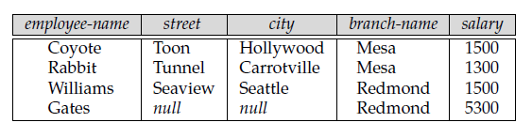
Right Outer Join
The Right JOIN keyword returns all rows from the right table (table2), with the matching rows in the left table (table1).
The result is NULL in the right side when there is no match.
Table 1
Table 2
Table 1 Right Join Table 2
Resultant Table

Slide 134
Emp_No | Name | Branch_No
11 | Smith | B001
23 | William | B007
34 | Simi | C006
List out the employee details along with their branch name using Right Outer Join
Employee
Select e.emp_no, e.name, b.branch_name from Employee e RIGHT OUTER JOIN Branch b ON e. branch_no = b. branch no
Branch_Name | Branch_No
Mumbai | B001
Mumbai | B007
Pune | C009
Banglore | F007
Branch

Slide 135
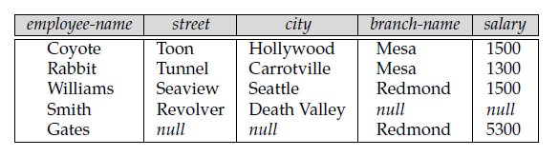
Full Outer Join
It does both of those operations, padding tuples from the left relation that did not match any from the right relation
As well as tuples from the right relation that did not match any from the left relation and adding them to the result of the join.
Table 2
Table 1
Table 1 Full Outer Join Table 2
Resultant Table

Slide 136
Emp_No | Name | Branch_No
11 | Smith | B001
23 | William | B007
34 | Simi | C006
List out the employee details along with their branch name using Full Join
Employee
Select e.emp_no, e.name, b.branch_name from Employee e FULL OUTER JOIN Branch b ON e. branch_no = b. branch no
Branch_Name | Branch_No
Mumbai | B001
Mumbai | B007
Pune | C009
Banglore | F007
Branch

Slide 137
SUBQUERIES
A subquery is a form of SQL statement that appears inside another SQL statement
Subquery also termed as Nested Queries
First table is called Parent statement which uses rows returned by subqueries
Subqueries can be used for
Inserting records
Creating table
Update records

Slide 138
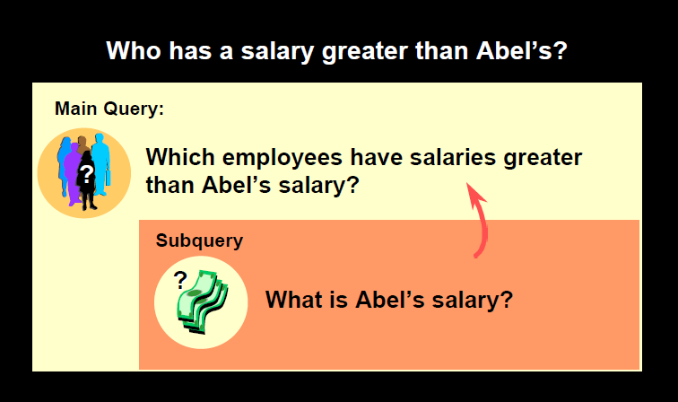

Slide 139
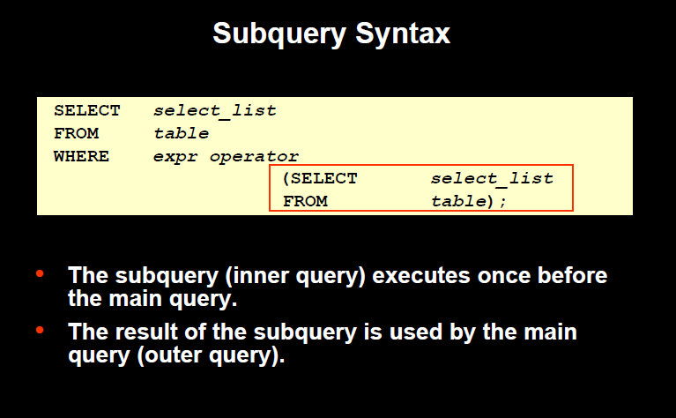

Slide 140
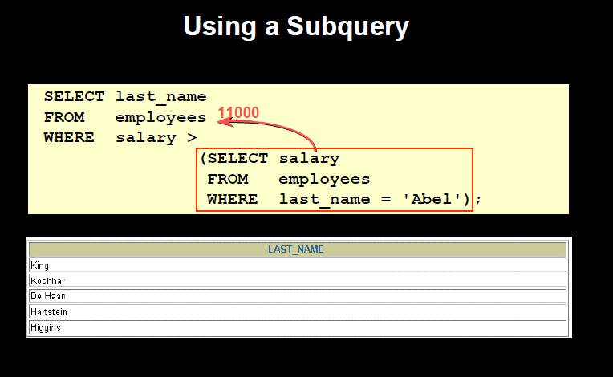
Retrieve last name of employees having salary greater than Abel’s salary

Slide 141
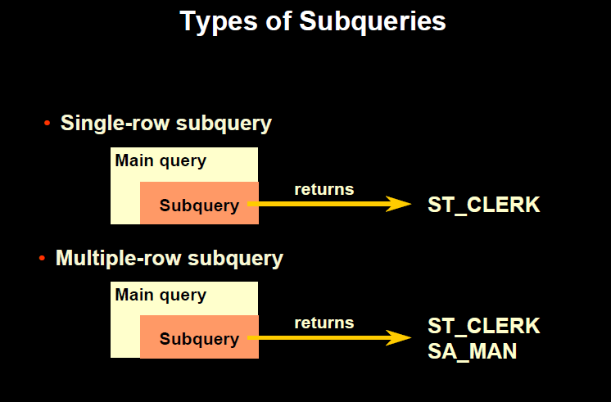

Slide 142
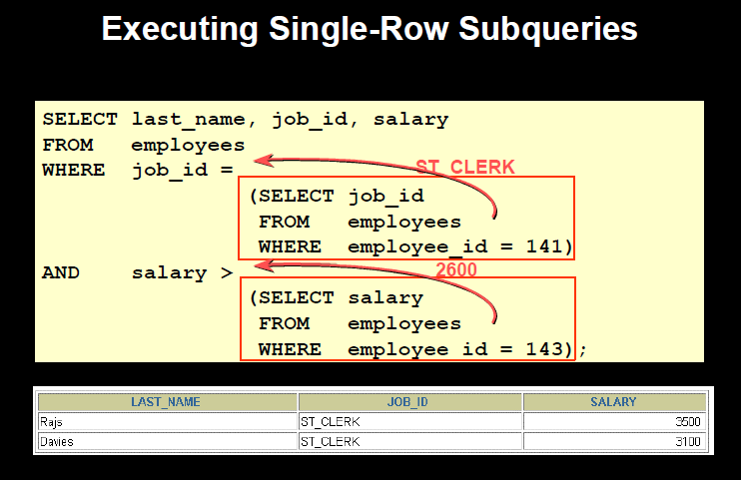
Retrieve the last name, job id and salary of the employees who are having same job id as employee id 141 and salary is greater than employee id 143

Slide 143
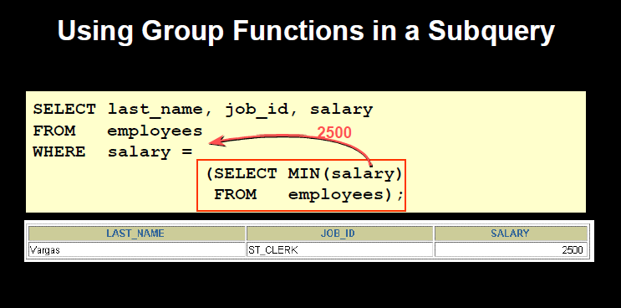
Retrieve the last name, job id and salary of the employee who has minimum salary in the department

Slide 144
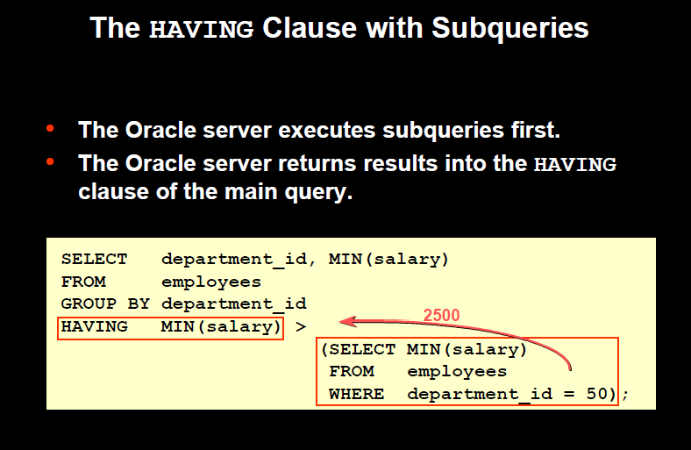
Retrieve the department id and minimum salary of employees of each department having average salary greater than minimum salary of those employees who work in department no 50

Slide 145
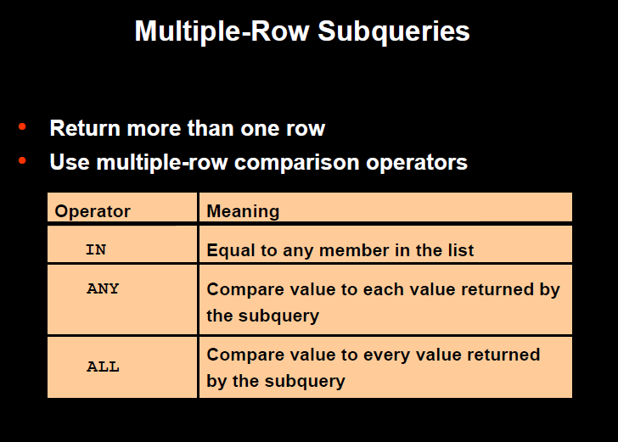

Slide 146
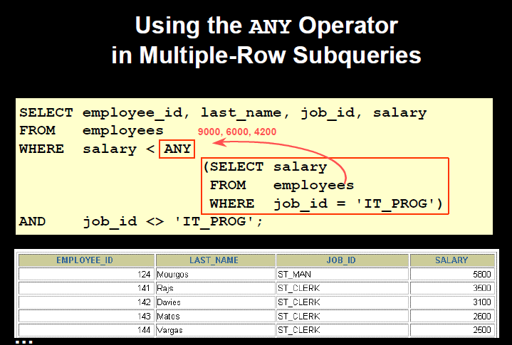
Retrieve the records of employee whose salary is less than any IT_Prog employee

Slide 147
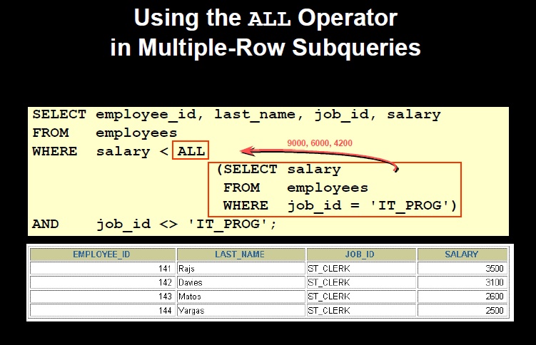
Retrieve the records of non IT_Prog employee whose salary is less than all IT_Prog employees

Slide 148


THANK YOU

